Slide 1
X-rays:
production
Dr Gulshan Kumar
MVSc PhD

Slide 2
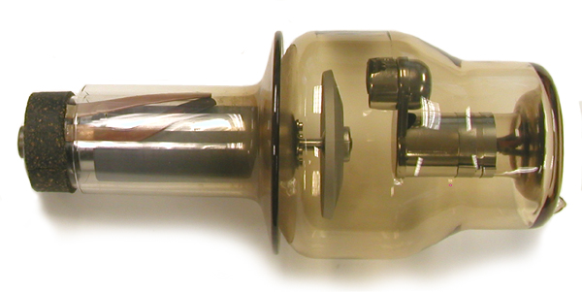
Anode (Rotatory)
Evacuated glass tube
An x-ray tube
Cathode

Slide 7
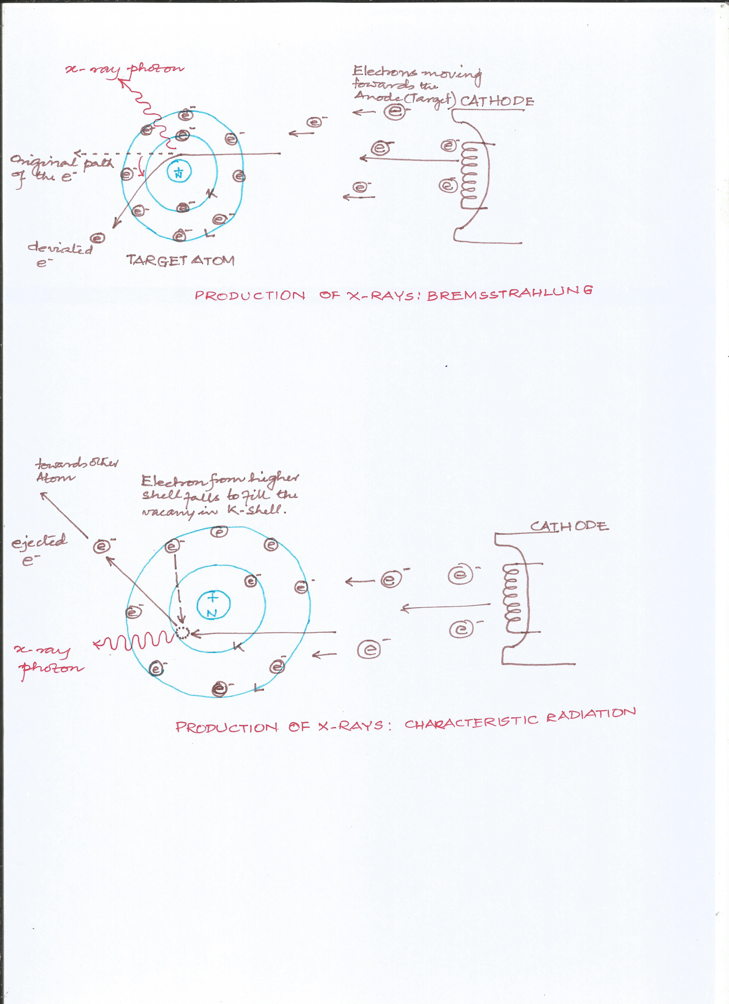
The electron (in red circle) had started moving from the cathode, it entered the target atom at ‘A’ and was passing so close to the nucleus that the +ve charge in the nucleus attracted it causing its deviation from its original path ‘B’. This change in direction caused conversion of some of the kinetic energy of this electron into an x-ray photon, due to an abrupt change in direction, also its own ‘original’ KE was reduced
B
A

Slide 8
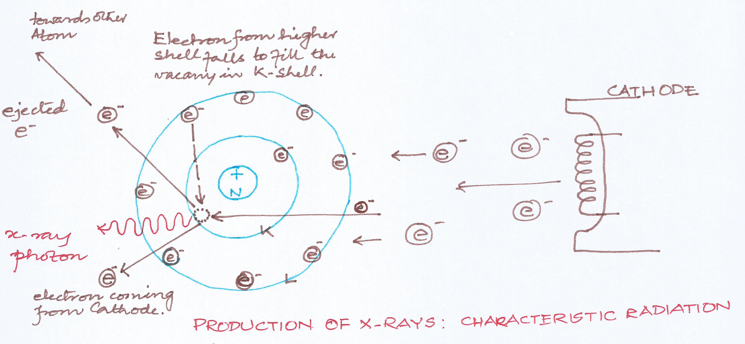
The electron (in red circle) had started moving from the cathode, it entered the target atom at ‘A’ and knocked the electron of the K-shell of the target atom (in green circle). Some fraction of its KE was utilised in knocking out the electron in green circle (equivalent to its binding energy). A hole was created (dotted circle) in the K-shell which was then filled up by an electron (in blue circle) from higher (L) shell. The difference of energies of K and L shell was released in the form of an x-ray photon (Characteristic radiation) .
A

Slide 9
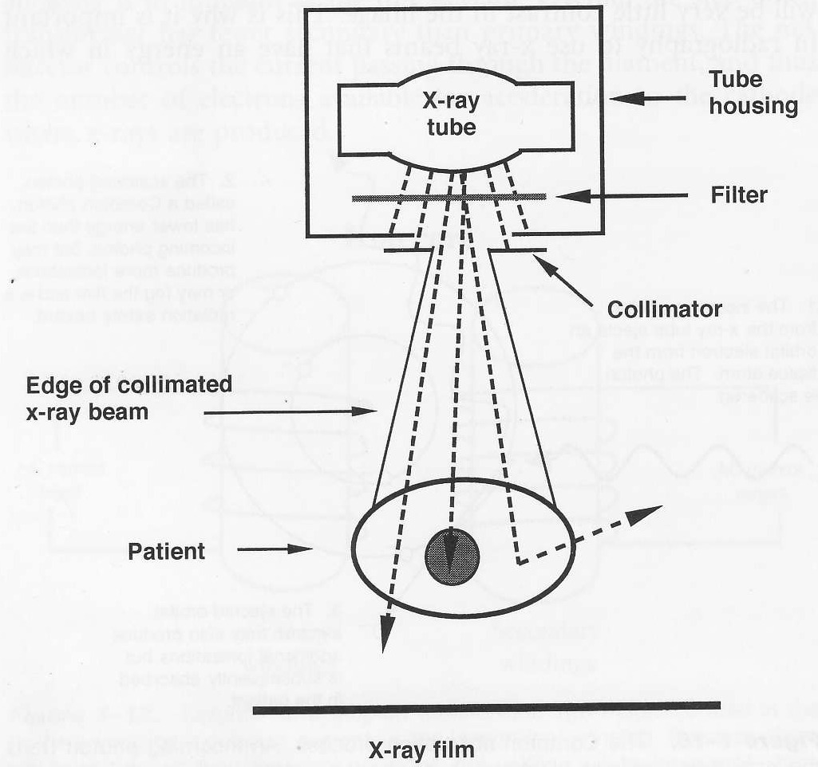

Slide 11
The heel effect

Slide 12
The rotating beveled anode
The Heel
The Filament at cathode
Bevel of the anode

Slide 13
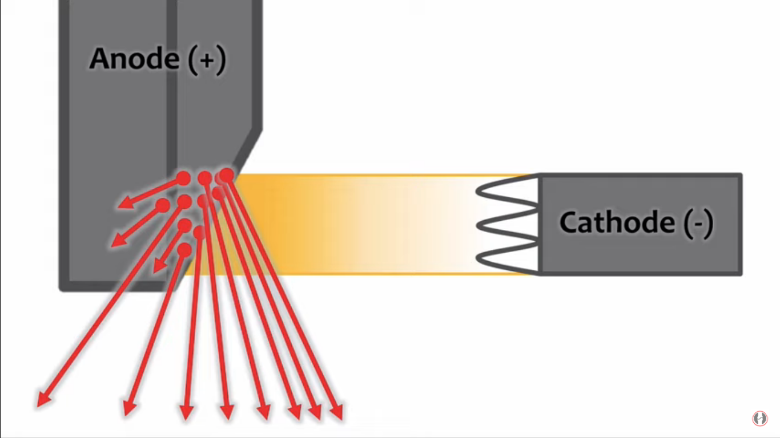
The photons produced towards the cathode side of the target have to traverse less through target matter before they come out because of the bevelled target, hence greater no. of photons escape on the cathode side, hence the beam is more intense on cathode side
The photons produced towards the anode side of the target have to traverse more through target matte, most of them get absorbed in the anode ‘heel’ and only few of them come out, hence lesser no. of photons escape on the anode side, hence the beam is less intense on anode side
Cathode side
Anode side

Slide 14
