Slide 1
Information
On
LN2 & cryocan
Dr. Vikas Sachan
Veterinary Gyn and Obst

Slide 2
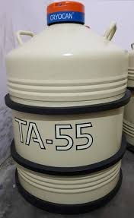
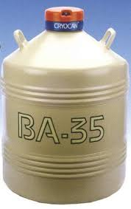
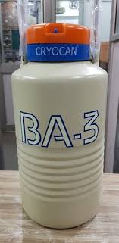
Liquid Nitrogen (LN₂)
- AI center
- container for LN₂ for storage (52/55 liter)
- frozen semen straws storage cryocan (35 litre)
- Small portable LN2 container (3-5 litre)

Slide 3
Liquid nitrogen
- BP -196⁰C and FP -212⁰C
- In special container : LN₂ cylinder or cryocan
- Double-walled metal/aluminium vacuum vessel
- Efficient insulation system
- Inner chamber, outer chamber and a bad heat
conductor non-metallic neck
- A high quality insulator material (No heat
exchange) with maintained vacuum system
: Between inner and outer chamber

Slide 4
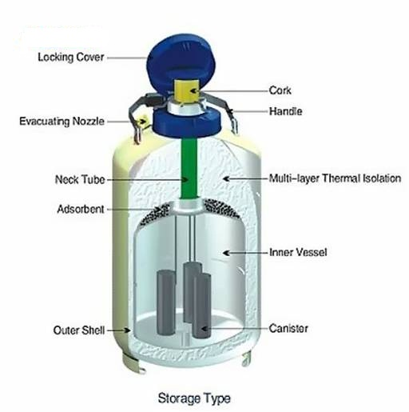

Slide 5
Failure of vacuum system
- Loss of the gas
Frost line (top of container) - increased evaporation
(due to damaged container)
Neck tube - delicate part
(hold weight of inner chamber)

Slide 6
LN₂ cylinder
-Kept on rubber, jute or wooden carpet
- No Wet floor, hard cement or chemicals
- corrosion - Loss of vacuum system
- Always in vertical position
- Never be tilted or rolled to avoid any damage
- No piling one cylinder above other

Slide 7
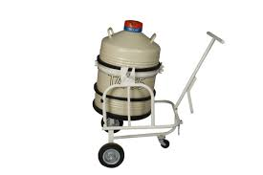
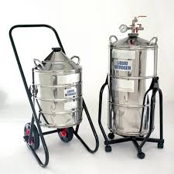
LN₂ cylinder
- Shifting with platform base trolley
- Place in cool place with no direct sunlight
- LN₂ holding capacity : reduced

Slide 8
- Arrangement of extra cryocan
(in case of appearance of frost line)
Careful handling to avoid damage to vacuum knob
No jerk or shock/vibration during lifting/carrying
- Damage to the neck tube: loss of vacuum system
No Punching or drilling on the container wall

Slide 9
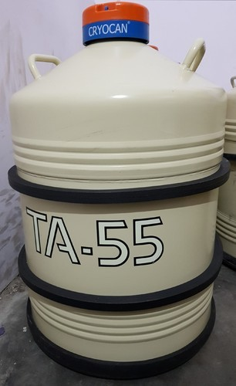
LN₂ cylinder - Secured with rubber band rings
(As shock absorbent)
- Careful while transporting filled cryocans in bus or train
(sudden evaporation : Panic situation)

Slide 10
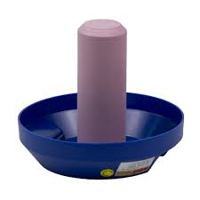
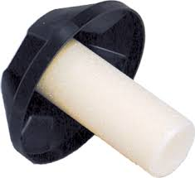
Neck : dry with cloth or tissue paper time to time
(to avoid jamming of the neck plug)
Lid should : vertical position
Lids or canisters : never be exchanged
(damage due to tight fitting)
(frost formation due to loose fitting)

Slide 11
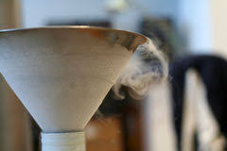
No Frequent opening, closing or shifting
: to keep evaporation rate minimum.
Charging and filling : Slowly
Non-splashing manner
Use funnel
Avoid overfilling of gas.

Slide 12
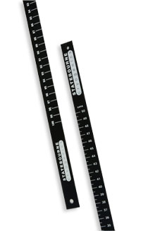
Metal or wooden dipstick :measure the LN₂ level
(No Plastic or any hollow rod)

Slide 13
Filling new container : Wait for 24 hr for charging
Refilled to its full capacity
Frost appearance on first filling
(Vanishes by its own within one or two hours)
First noting of the LN₂ level : After 10 days
(Normal time taken for thermal balance by the new
container)

Slide 14
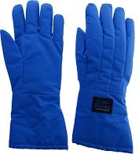
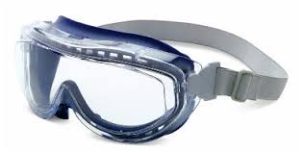
- Use of protective clothing and eye glasses
- To avoid any direct contact of the LN₂
- LN₂ : Non-toxic and Non-inflammable gas
- But direct contact : tissue damage (frost bite)
- Water should be used immediately
- Poorly ventilated room : Suffocation

Slide 15
- Frozen semen doses - in a well-ventilated room
(all weather safe storage area)
Identification marking and mapping of semen storage
Frozen semen : No exposure above liquid nitrogen
(thermal shock)
Canister : Not exposed over and above the neck
Transferring the semen straws : Use thermocole box
(Fast transferring : 5 seconds exposure of straw in air)
Maintain proper level of liquid nitrogen
Details of semen dose and AI centre
: Updated after every supply

Slide 16
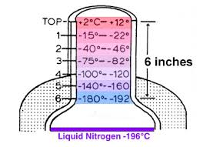
- LN₂ level below the canister
- Lost cold chain
- whole of the semen stored spoiled
- Discard all the semen doses
- Replenish the LN₂
At the time of AI , Semen straw
- No exposure above LN₂ : more than 10 seconds

Slide 17
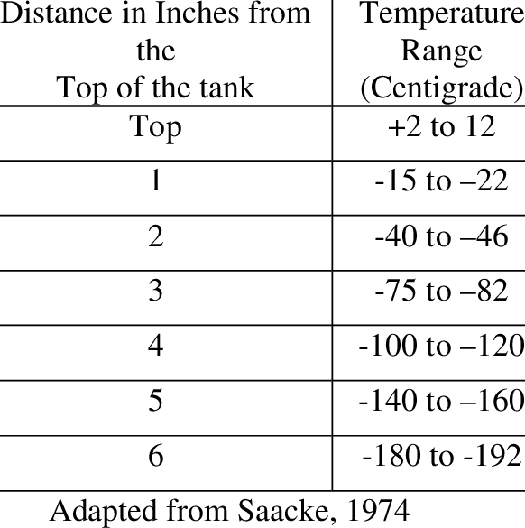

Slide 18
- AI kit - Scissors, Thermometer/thaw monitor, Thawing Tray, Forceps, Sheaths with sheath container, AI Gun with container, Plastic gloves, Lubricant, Isopropyl alcohol/ surgical spirit, Tissue papers, Clean towel, Thermos-flask with hot water, apron, Tags, pins and tag applicator etc.
Stainless steel AI guns and AI sheath
: Approved by BIS (Bureau of Indian Standard)

Slide 19
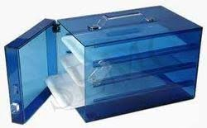
- Clean AI gun, scissors and other accessories
: When soiled
: Once a week with hot water and air dry
- Sanitize the AI gun and the scissor
: With Isopropyl alcohol after every insemination
- Surgical spirit and soaps : lethal to semen
- Aprons, towel etc : washed properly
- Cold fumigation in formaldehyde chambers (AI box)

