Slide 1
Lateral ear canal resection (Zepp’s Operation/procedure)
Dr Gulshan Kumar
MVSc, PhD

Slide 2
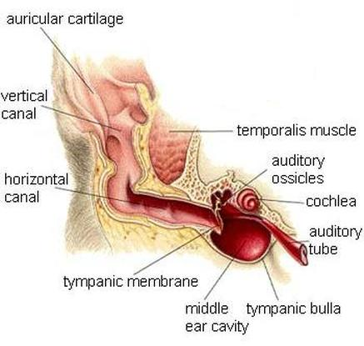

Slide 6
