Slide 1
The sTomach
Gulshan Kumar
Dept. of Veterinary Surgery & Radiology
College of Veterinary Science and Animal Husbandry
U.P. Pt. Deen Dayal Upadhyaya Pashuchikitsa Vigyan Vishwavidyalaya evam Go Anusandhan Sansthan, Mathura- 281 001

Slide 2
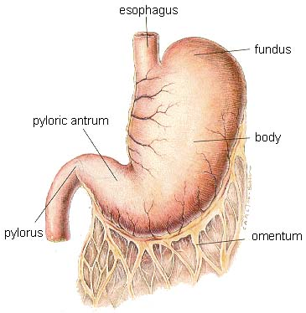
The stomach
Surgical anatomy
Stomach cardia, fundus. Body, pyloric antrum, pyloric canal, pyloric ostium.
Oesophagus entry at cardiac ostium of stomach.
Fundus is relatively smaller in canine and dorsal to cardiac ostium. On radiography gas present.
Body of stomach: lies against left lobe of liver
Pyloric antrum: funnel shaped, open into pyloric canal.
Pyloric ostium: end of pyloric canal and empties into duodenum.
Blood supply: Aorta, Celiac artery, Gastric artery on lesser curvature & gastroepiploic artery on greater curvature of stomach.

Slide 3
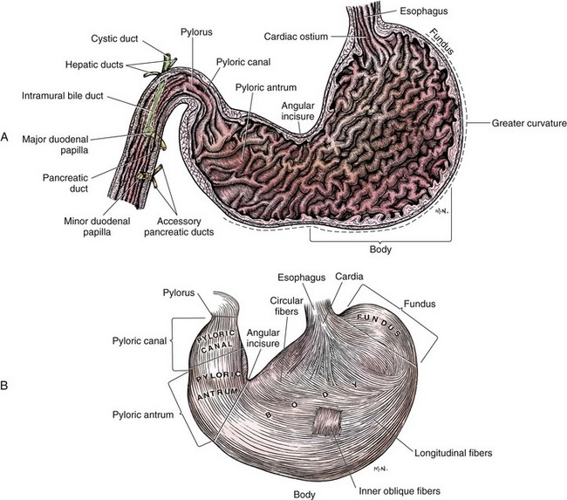

Slide 4
Affections of the stomach

Slide 5
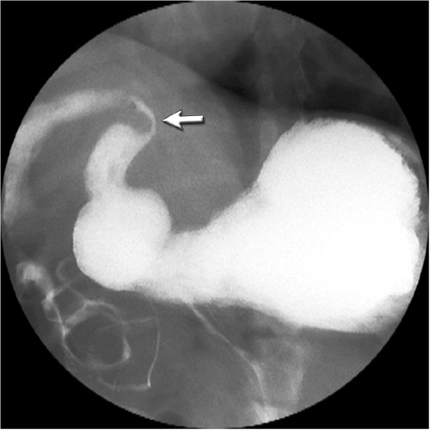
Pyloric stenosis
Diagnosis: on the basis of the history and sign discussed above.
Radiography
Survey Radiograph of abdomen may reveal gastric distention (usually filled with fluid)
Contrast Radiography reveals delayed emptying – Pyloric wall thickening and/or filling defect in the pylorus.
Note: Normal elimination of liquid barium does not rule out gastric outflow obstruction

Slide 6
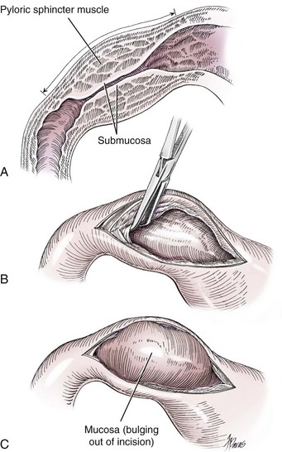

Slide 7
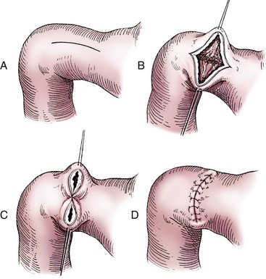

Slide 8
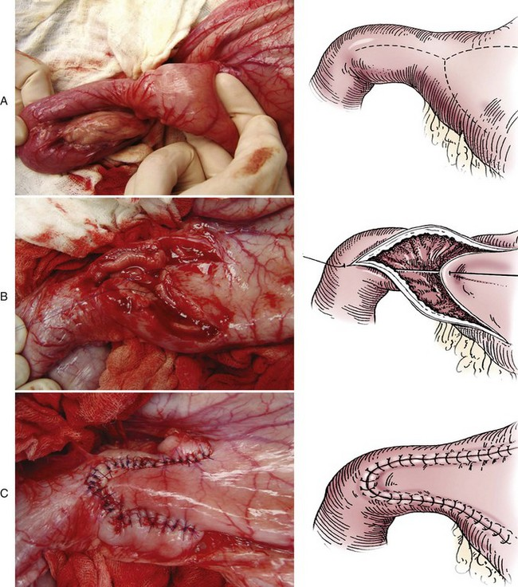

Slide 9
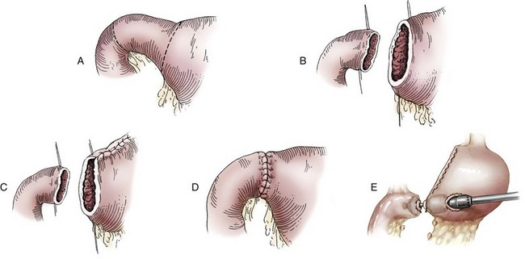

Slide 10
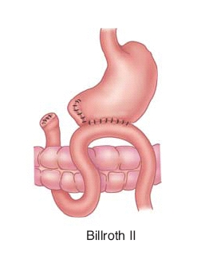
Pyloric stenosis

Slide 11
Thanks

