Slide 1
Fractures-4
Gulshan Kumar
MVSc, PhD
Dept. of VSR, College of Veterinary Science & Animal Husbandry, DUVASU, Mathura- 281 001

Slide 2
methods of management
Dept. of VSR, College of Veterinary Science & Animal Husbandry, DUVASU, Mathura- 281 001

Slide 3
The METHODS
Closed reduction and immobilization
Casts and splints
POP, Fibre glass
Thomas, Meta
Dept. of VSR, College of Veterinary Science & Animal Husbandry, DUVASU, Mathura- 281 001

Slide 4
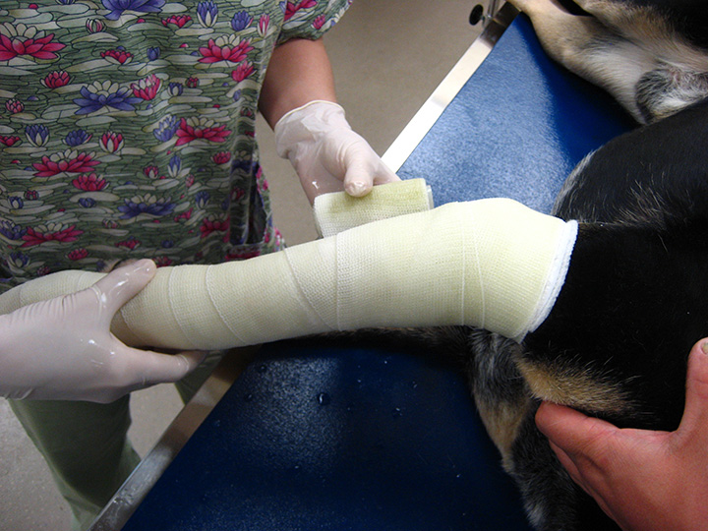
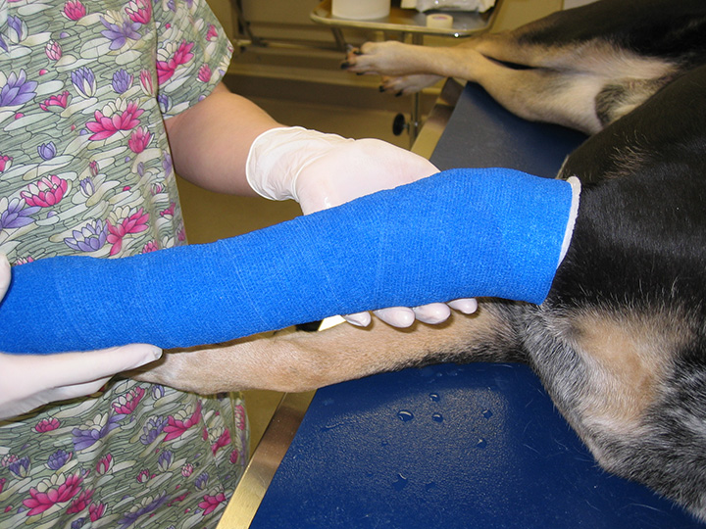
The METHODS
Closed reduction and external fixation (CREF)
Dept. of VSR, College of Veterinary Science & Animal Husbandry, DUVASU, Mathura- 281 001

Slide 5
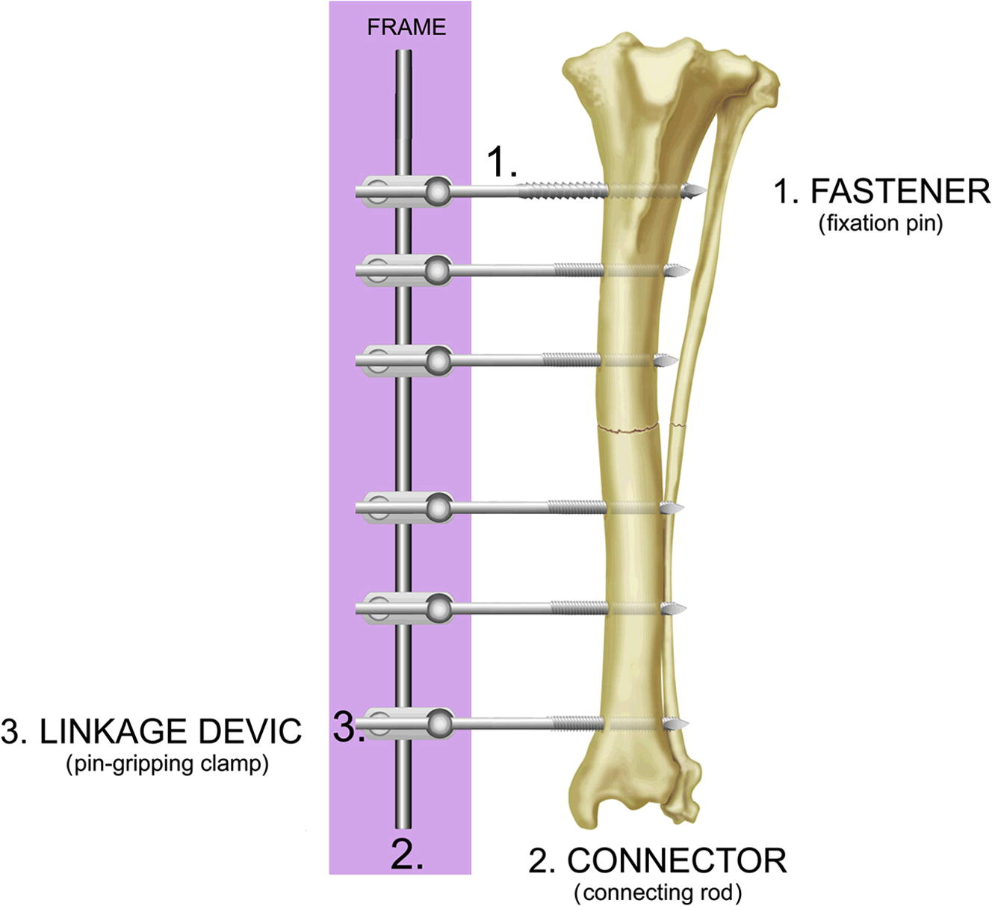
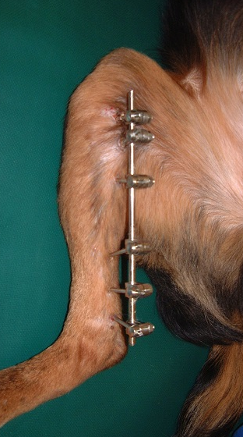
The METHODS
Open/close reduction external skeletal fixation
Dept. of VSR, College of Veterinary Science & Animal Husbandry, DUVASU, Mathura- 281 001

Slide 6
The METHODS
Open reduction without internal fixation
Open reduction followed by casts
Dept. of VSR, College of Veterinary Science & Animal Husbandry, DUVASU, Mathura- 281 001

Slide 7
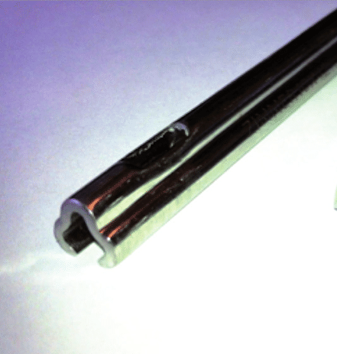
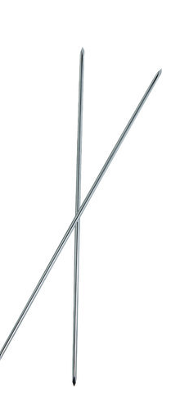
The METHODS
Open reduction and internal fixation (ORIF)
Intra-medullary
Pins: Steinmann, Kirschner-wire (K), Rush pins, Kuntscher nail Interlocking Nail
Dept. of VSR, College of Veterinary Science & Animal Husbandry, DUVASU, Mathura- 281 001

Slide 8
The METHODS
Open reduction and internal fixation (ORIF)
Extramedullary
Screws
Cancellous & cortical
Lag screws
Cannulated
Self tapping
Dept. of VSR, College of Veterinary Science & Animal Husbandry, DUVASU, Mathura- 281 001

Slide 9
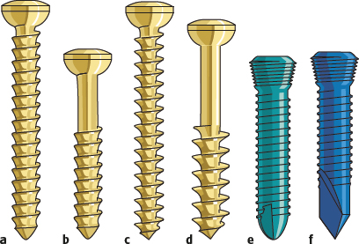
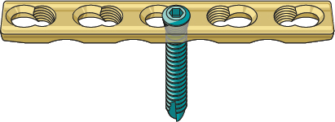
The METHODS
Open reduction and internal fixation (ORIF)
Extramedullary
Screws
Cancellous & cortical
Lag screws
Cannulated
Self tapping
Locking
Dept. of VSR, College of Veterinary Science & Animal Husbandry, DUVASU, Mathura- 281 001

Slide 10
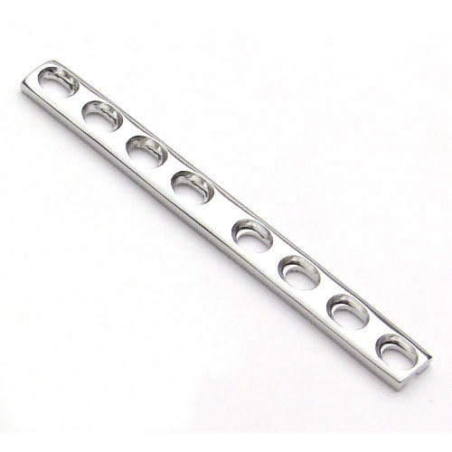
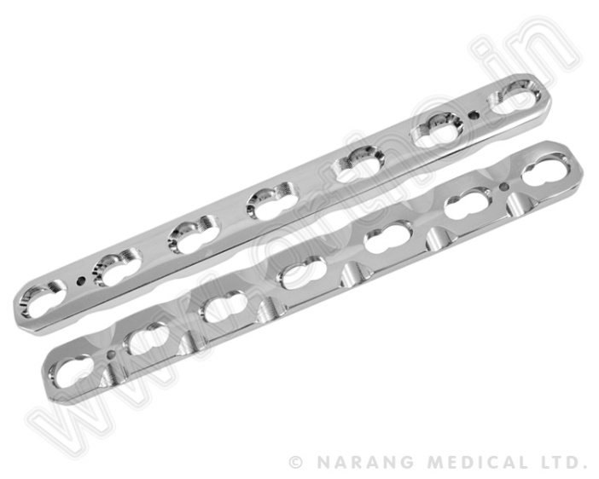
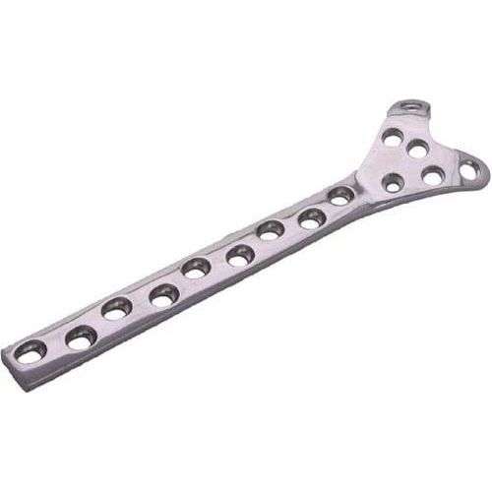
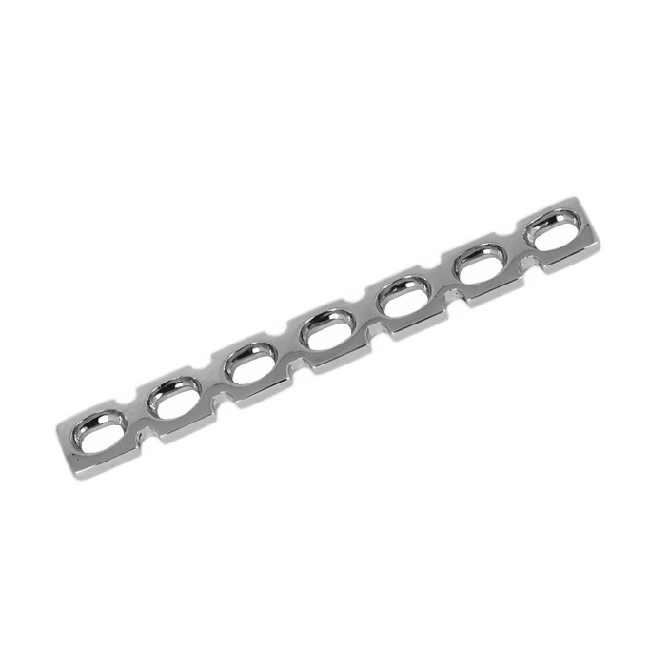
The METHODS
Open reduction and internal fixation (ORIF)
Extramedullary
Plate & Screws
Neutrallization plate
Dynamic compression plate-DCP
Limited contact Dynamic compression plate-LC-DCP
Buttress plates
Reconstruction Plates
Dept. of VSR, College of Veterinary Science & Animal Husbandry, DUVASU, Mathura- 281 001

Slide 11
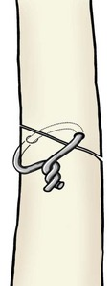
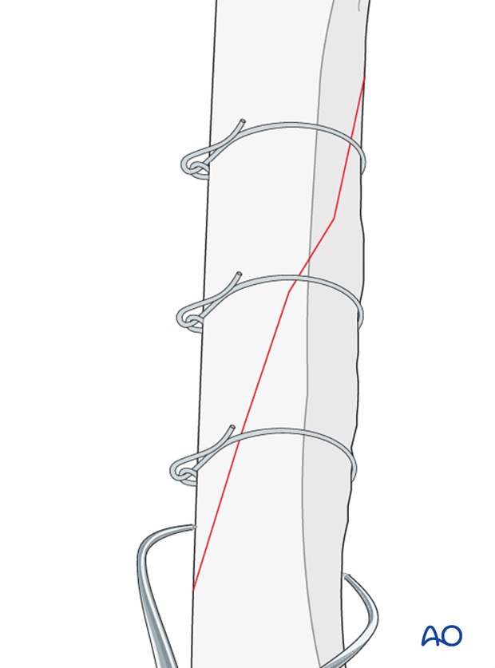
The METHODS
Open reduction and internal fixation (ORIF)
Extramedullary
Wire (cerclage, hemicerclage)
Dept. of VSR, College of Veterinary Science & Animal Husbandry, DUVASU, Mathura- 281 001

Slide 12
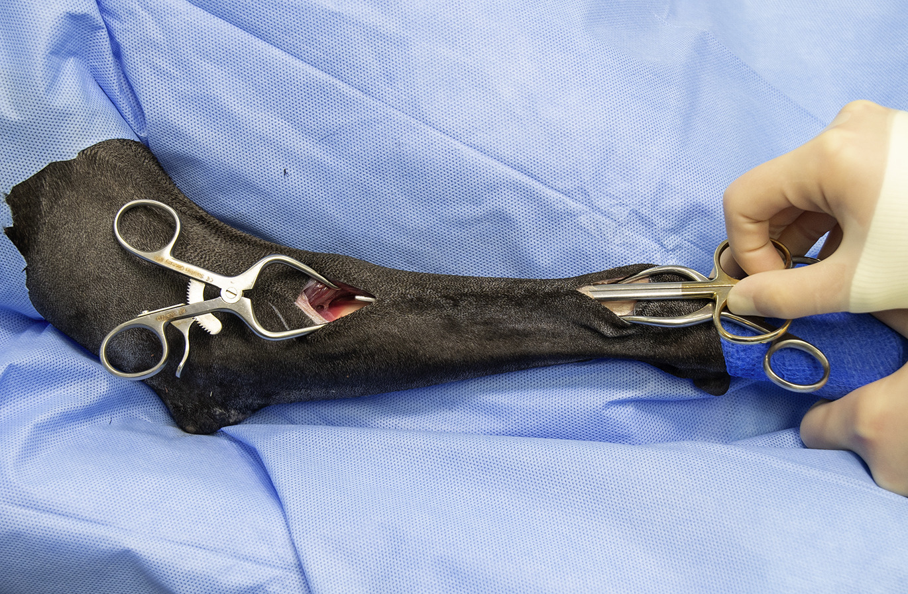
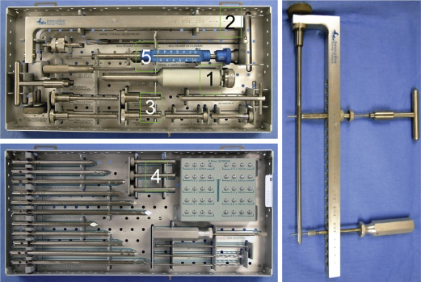
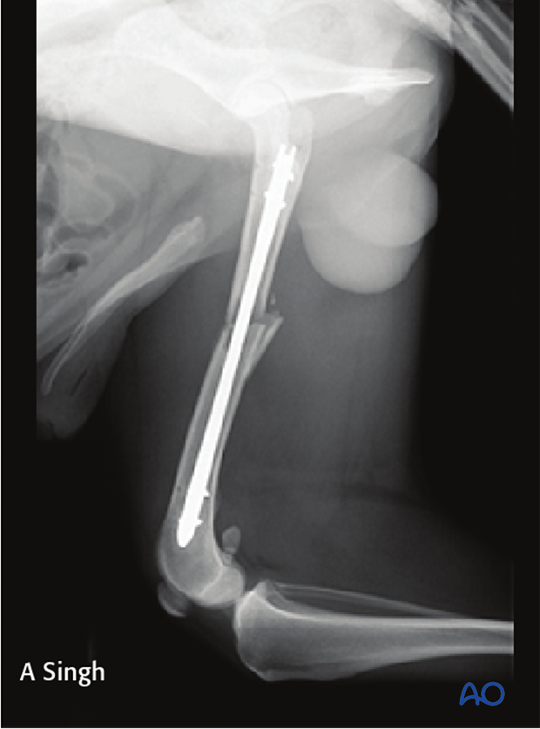
The METHODS
Closed reduction and internal fixation (CRIF)
ILN
MIPO
Dept. of VSR, College of Veterinary Science & Animal Husbandry, DUVASU, Mathura- 281 001

Slide 13
Thanks

