Slide 1

Conformation of horse
Gulshan Kumar
MVSc, PhD
Dept. of VSR, College of Veterinary Science & Animal Husbandry, DUVASU, Mathura- 281 001

Slide 2
conformation
  shape or structure of a horse, and it can impact a horse's athletic ability
  From distance
  Up close
Dept. of VSR, College of Veterinary Science & Animal Husbandry, DUVASU, Mathura- 281 001

Slide 3
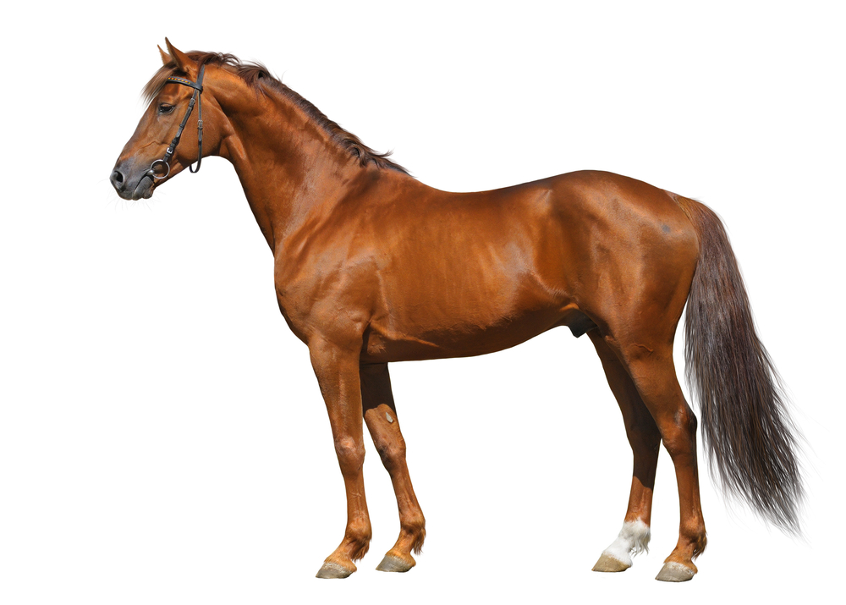
Points???

Slide 4
conformation
  Balance
Dept. of VSR, College of Veterinary Science & Animal Husbandry, DUVASU, Mathura- 281 001

Slide 5
conformation
  Balance
Dept. of VSR, College of Veterinary Science & Animal Husbandry, DUVASU, Mathura- 281 001

Slide 6
conformation
  Balance
Dept. of VSR, College of Veterinary Science & Animal Husbandry, DUVASU, Mathura- 281 001

Slide 7
conformation
  Balance
Dept. of VSR, College of Veterinary Science & Animal Husbandry, DUVASU, Mathura- 281 001

Slide 8
conformation
  Balance
Dept. of VSR, College of Veterinary Science & Animal Husbandry, DUVASU, Mathura- 281 001

Slide 9
conformation
  Angles
Dept. of VSR, College of Veterinary Science & Animal Husbandry, DUVASU, Mathura- 281 001

Slide 10
conformation
  Angles
Dept. of VSR, College of Veterinary Science & Animal Husbandry, DUVASU, Mathura- 281 001

Slide 11
conformation
  Ratios
Dept. of VSR, College of Veterinary Science & Animal Husbandry, DUVASU, Mathura- 281 001

Slide 12
conformation
  Ratios
Dept. of VSR, College of Veterinary Science & Animal Husbandry, DUVASU, Mathura- 281 001

Slide 13
conformation
  Front leg conformation
Dept. of VSR, College of Veterinary Science & Animal Husbandry, DUVASU, Mathura- 281 001

Slide 14
conformation
  Front leg conformation
Dept. of VSR, College of Veterinary Science & Animal Husbandry, DUVASU, Mathura- 281 001

Slide 15
conformation
  Hing leg conformation
Dept. of VSR, College of Veterinary Science & Animal Husbandry, DUVASU, Mathura- 281 001

Slide 16
conformation
  Hing leg conformation
Dept. of VSR, College of Veterinary Science & Animal Husbandry, DUVASU, Mathura- 281 001

Slide 17
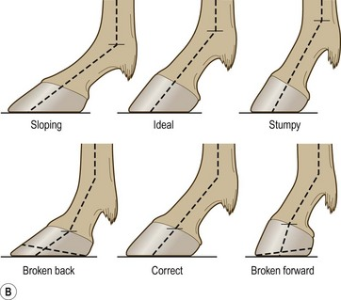
conformation
  Lower leg conformation
Dept. of VSR, College of Veterinary Science & Animal Husbandry, DUVASU, Mathura- 281 001

Slide 18
conformation
  Muscling
Dept. of VSR, College of Veterinary Science & Animal Husbandry, DUVASU, Mathura- 281 001

Slide 19
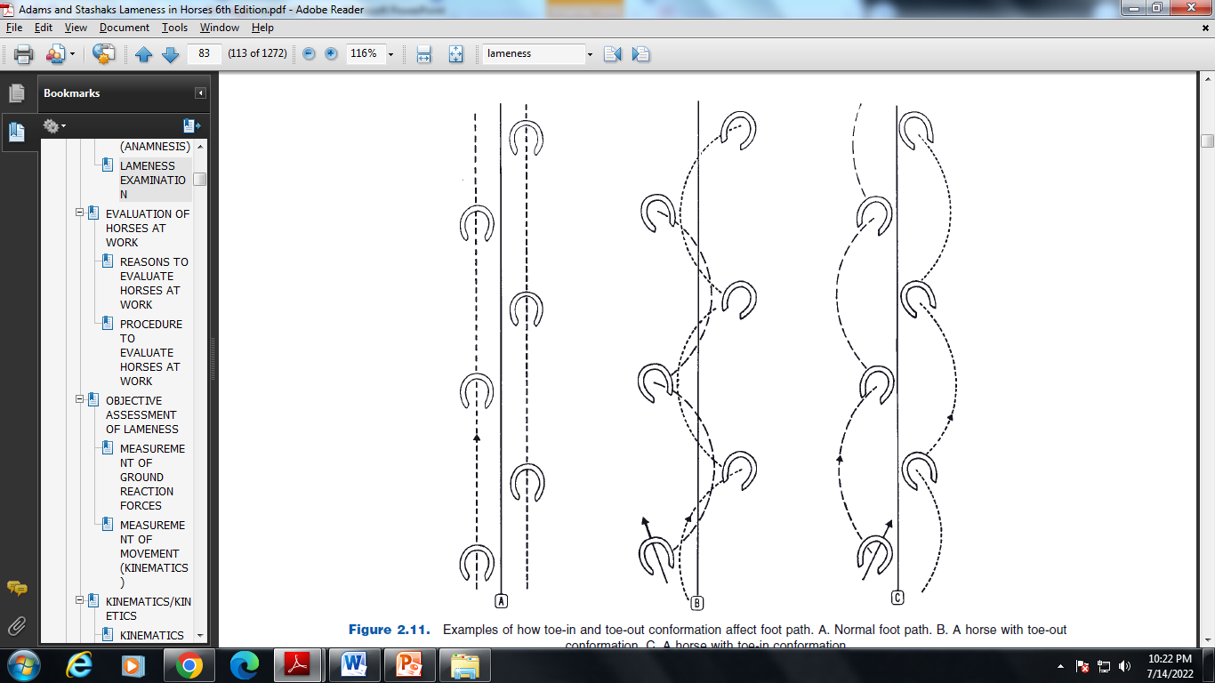
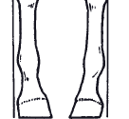
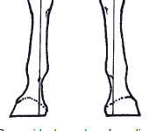
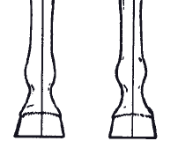
conformation
Paddling
Winging
  When in motion
Dept. of VSR, College of Veterinary Science & Animal Husbandry, DUVASU, Mathura- 281 001

Slide 20
conformation
  When in motion
Plaiting/rope walking
Dept. of VSR, College of Veterinary Science & Animal Husbandry, DUVASU, Mathura- 281 001

Slide 21
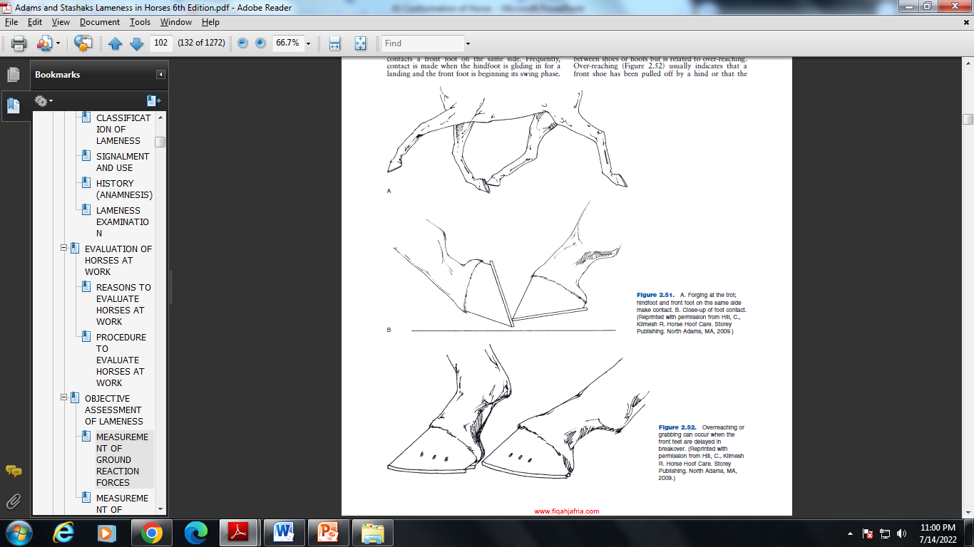
conformation
  When in motion
Interfering
Forging
Overreaching
Dept. of VSR, College of Veterinary Science & Animal Husbandry, DUVASU, Mathura- 281 001

Slide 22
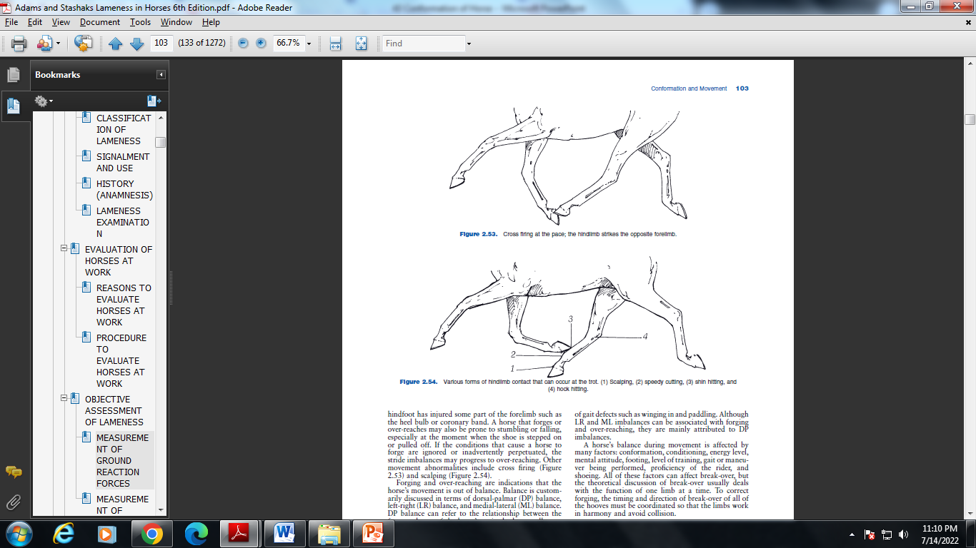
conformation
  When in motion
Shin Hitting
Hock Hitting
Speedy Cutting
Scalping
Dept. of VSR, College of Veterinary Science & Animal Husbandry, DUVASU, Mathura- 281 001

Slide 23
conformation
  When in motion
Cross-firing
Dept. of VSR, College of Veterinary Science & Animal Husbandry, DUVASU, Mathura- 281 001

Slide 24
lameness
Dept. of VSR, College of Veterinary Science & Animal Husbandry, DUVASU, Mathura- 281 001

Slide 25
lameness
Lameness is an indication of a structural or functional disorder in one or more limbs or the back that is evident while the horse is standing or at movement.
  OR
  Lameness is a term used to describe a horse’s change in gait, usually in response to pain somewhere in a limb, but also possibly as a result of a mechanical restriction on movement.
Dept. of VSR, College of Veterinary Science & Animal Husbandry, DUVASU, Mathura- 281 001

Slide 26
lameness
Lameness may be caused by
  Trauma
  Congenital or acquired anomalies
  Infections
  Metabolic disturbances
  Circulatory or nervous disorders
Lameness due to pain is most common
Dept. of VSR, College of Veterinary Science & Animal Husbandry, DUVASU, Mathura- 281 001

Slide 27
Examination for lameness
Objectives of examination for lameness
  To know whether the horse is lame
  Which limb or limbs are involved
  The site or sites of the problem
  The specific cause of the problem
  The appropriate treatment
  The prognosis for recovery
Dept. of VSR, College of Veterinary Science & Animal Husbandry, DUVASU, Mathura- 281 001

Slide 28
Examination for lameness
Steps in examination for lameness
  Complete history including signalment and use
  Visual exam of the horse at rest
  Palpation of the musculoskeletal system including hoof tester examination of the feet
  Observation of the horse in motion (usually at a straight walk and trot/lope followed by circling) appropriate treatment
  Manipulative tests such as fl exion tests
  Diagnostic anesthesia if necessary
  Diagnostic imaging
Dept. of VSR, College of Veterinary Science & Animal Husbandry, DUVASU, Mathura- 281 001

Slide 29
classification of lameness….
Supporting limb lameness
  Evident when supporting weight
Swinging limb lameness
  Evident when the limb is in motion
Mixed lameness
  Evident both when the limb is moving (swing phase) and when it is supporting weight (stance phase). Mixed lameness can involve any combination of structures affected in swinging or supporting-limb lameness.
Dept. of VSR, College of Veterinary Science & Animal Husbandry, DUVASU, Mathura- 281 001

Slide 30
….classification of lameness
Primary or baseline lameness
  To be examined before flexion tests
Compensatory/complementary lameness
  Evident when the limb is in motion
Dept. of VSR, College of Veterinary Science & Animal Husbandry, DUVASU, Mathura- 281 001

Slide 31
steps
History (Questions to be asked)
  How long has the horse been lame? (Acute/chronic???)
  Has the horse been rested or exercised during the lameness period?
  Has the lameness worsened/stayed the same/improved?
  Was the cause of lameness observed?
  Does the horse warm out of lameness?
  What treatment was given? Was it helpful?
  When was the horse last shod /trimmed?
Dept. of VSR, College of Veterinary Science & Animal Husbandry, DUVASU, Mathura- 281 001

Slide 33
Thanks

