Slide 1
Radiation Hazards and Safety
Dr Sanjay Purohit
Department of Surgery and Radiology DUVASU, Mathura
Prof. Sanjay Purohit – Educational & Confidential - contents – collected from different sources -not permitted for replication & commercial purposes

Slide 2
Early Effects
• Cells having high mitotic activity are most radiosensitive
Skin
2. G.I tract
3. Red bone marrow
4. Oropharynx
5. Testes
6. ovaries

Slide 3
Skin lesions– affects the basal cells
1. Skin erythema (Reddening)
2. Thinning of skin
3. Blistering
4. Poorly healing ulcer
5. malignant

Slide 4
• G.I Tract-- Loss of epithelium & impaired
renewal leads to diarrhoea
• Testes– affects spermatagonia
• Ovaries– mature follicle
• Oropharynx- moderate dose
1. Reddening & swelling of laryngeal lining
2. White diptheroid membrane– epithelite
3. Large dose– slow healing ulceration &
fibrosis

Slide 5
• Red bone marrow
1. WBC count drops in 2 days
2. Platelets by 6 days
3. RBC by 110 days

Slide 6
Late effects
• In High dose
1. Carcinogenesis
2. Cataractogenesis
3. Life-shortening

Slide 7
• Low dose effects
1. Somatic-- Carcinogenesis
2. Genetic-- a) Gene mutation
b) Chromosomal aberrations

Slide 8
•ALARA concept– As Low As Reasonably Achievable
•Reducing exposure limits further than recommended by balancing of benefits vs cost
•Planning radiology department protection
•Promoting awareness within department

Slide 9
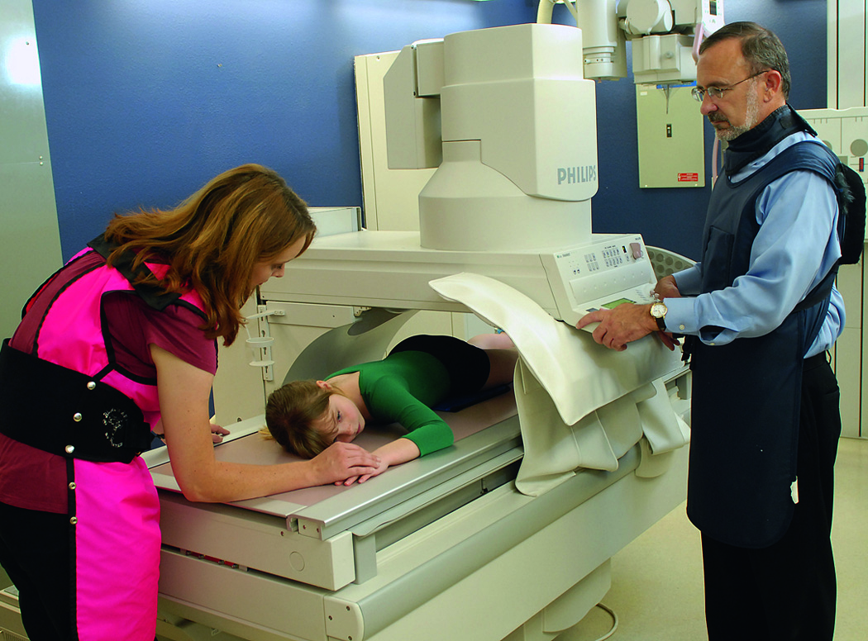
Radiation Protection
Patient
Fellow workers
Self

Slide 10
Units of Radiation
Roentgen (R) used for measurements in air
Rad (radiation absorbed dose) used for patient dose purposes
Rem (radiation equivalent man) used for worker protection purposes

Slide 11
Units of Radiation (traditional and SI units)
Traditional | SI Units
Roentgen | Coulombs/kg of air
Rad | Gray (Gy)
Rem | Sievert (Sv)

Slide 12
Dose-Limiting Recommendations Replaced MPD (maximum permissible dose) in 1994
Occupationally exposed workers Annual: 5 rem (50 mSv) per year (ED) Cumulative: 1 rem (10 mSv) times years of age
General population – .1 rem (1 mSv) per year

Slide 13
Pregnant Technologists
What is the dose limit for a pregnant technologist per month?
What is it for the entire gestational period?

Slide 14
Radiation monitoring devices:
1. Pocket dosimeter
2. Film badges
3. Thermoluminescent dosimeter (TLD) badges

Slide 15
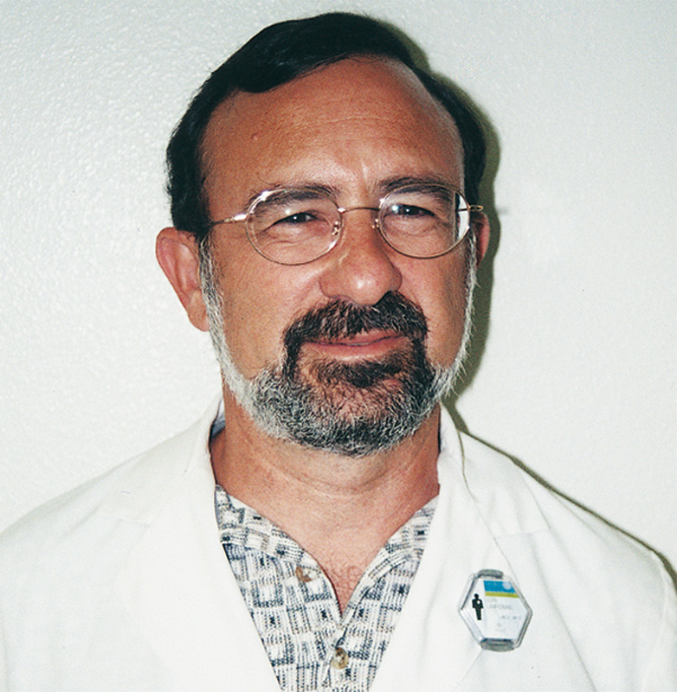
Personnel Monitoring
Film badge

Slide 16
Pocket Dosimeter
•Resembles fountain pain with in-built
ionization chamber & electrometer
Adv- immediate reading
Dis-adv– easily damaged
unreliable in inexperienced hands

Slide 17
Film Badges
• Dental film with copper & plastic filters
with lead backing
Adv–
1. simple to use
2. Inexpensive
3. Readily processed
4. Permanent record
Disadvantages
•Damageable
•Not reusable
•Lower sensitivity
•Error about 10 to 20 %
•Can be fogged by heat

Slide 18
TLD Badges
•Crystalline material trap electrons in crystal
lattice which are released in form of light
when heated in controlled condition.
•Measured by photomultiplier device
•Lithium fluoride is material used
•Advantages
1.Very small
2.Sealed in Teflon (less chance of damage)
3.Low exposure limit
4.Accuracy + 5%
5.Less sensitive to heat
6.Reusable worn after in 3 months
Disadvantages
Expensive
No permanent record

Slide 19
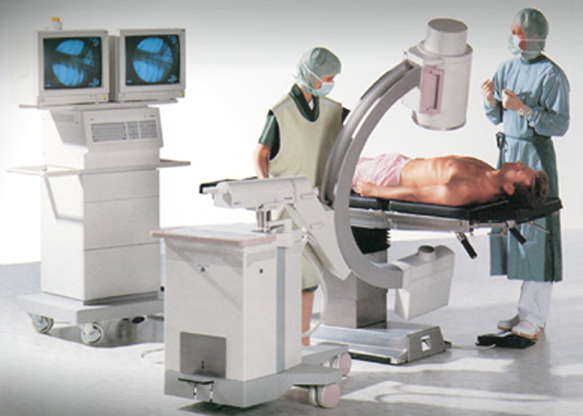
ALARA Principles
Always wear a personnel monitor.
Radiology personnel should not restrain patients.
Sound radiographic exposure factors
Cardinal rules of radiation protection:
– Time
– Distance
– Shielding
Mobile fluoroscopy or C-arm

Slide 20
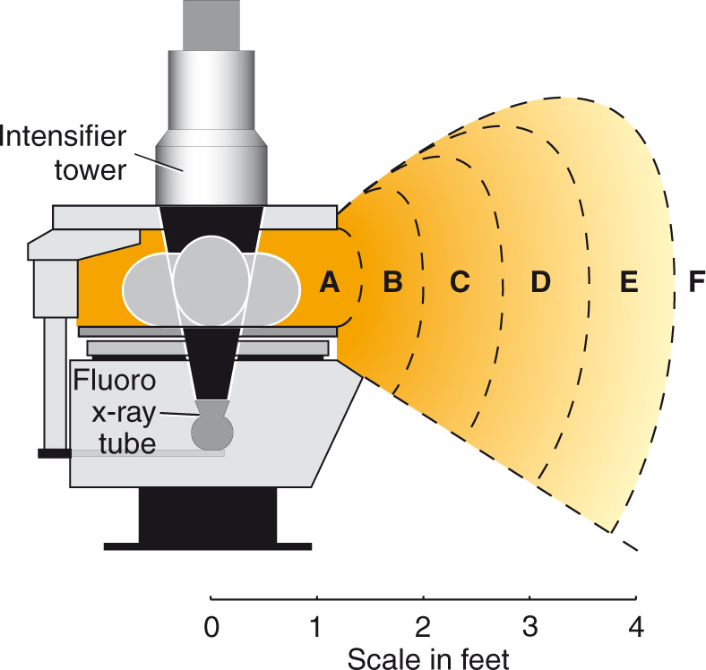
Fluoroscopy exposure patterns (without tower drape shields in place)

Slide 21
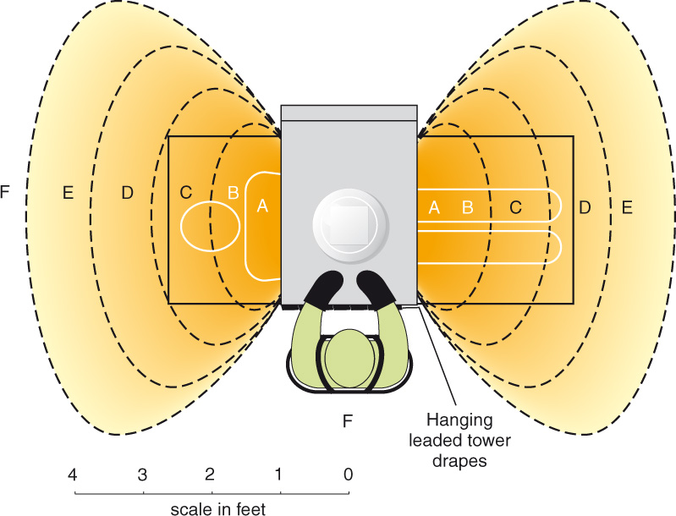
Worker Protection During Fluoroscopy
Fluoroscopy exposure patterns
(with tower drape shields in place)

Slide 22
Fluoroscopy Safety Practices
Bucky slot cover
Lead drape
.5 mm lead apron
Exposure limit: 10 R/min

Slide 23
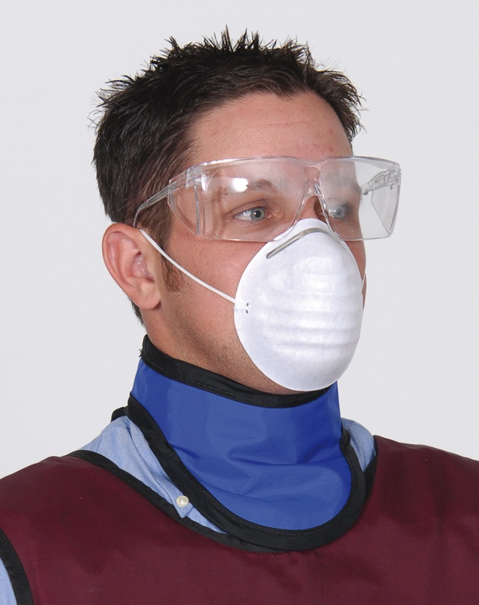
Thyroid shield with protective apron

Slide 24
Patient Protection
Minimum repeat radiographs
– Clear instructions
– Positioning and exposure factors

Slide 25
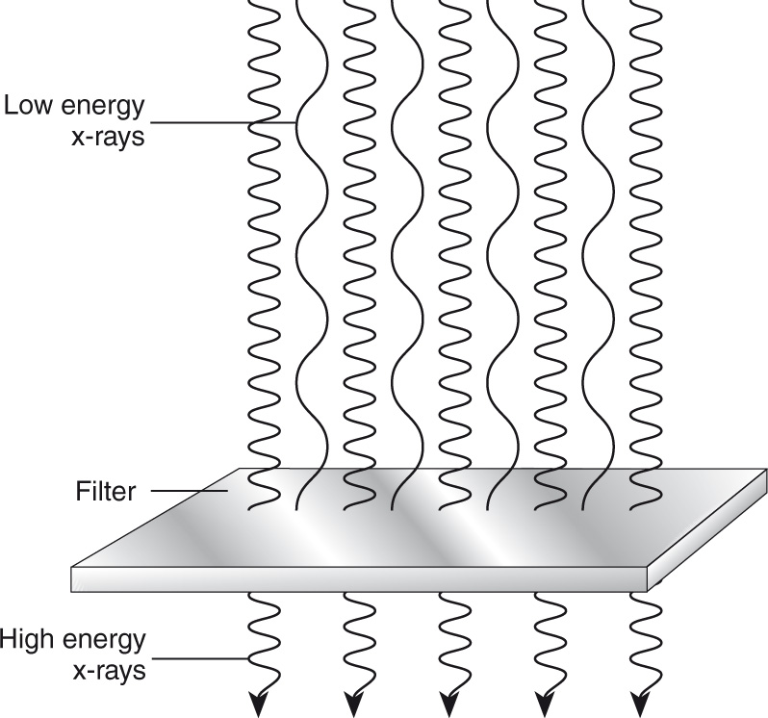
Radiation Protection Practices
Minimum repeat radiographs
Correct filtration
– Inherent and added
– 2.5 mm Al total

Slide 26
Close four-sided collimation: One of the best ways of reducing patient exposure! (Remember divergence of x-ray beam.)

Slide 27
Radiation Protection Practices
Minimum repeat radiographs
Correct filtration
Accurate collimation
Types of collimators
– Manual type
– Positive-beam limitation (PBL)

Slide 28
Radiation Protection
Minimum repeat radiographs
Correct filtration
Accurate collimation
Specific area shielding
– Shadow shields
– Contact shields

Slide 29
Radiation Protection
Gonadal contact shields
– 1 mm lead equivalent
– Reduces dose 50% to 90%

Slide 30
Radiation Protection
Minimum repeat radiographs
Correct filtration
Accurate collimation
Specific area shielding
Protection for pregnancies

Slide 31
Protective Measures
1. Exposure time– total dose to a person for
particular rate is directly proportional to
exposure time
2. Distance– Longer the distance less is exposure
3. Lead barrier– thickness of lead barrier is stated
in half-value layer (Lead apron, Gloves, Goggles etc)

Slide 32
Dose reduction in Radiography
Beam filtration– Aluminium
Beam collimation
Gonadal shielding
High speed image receptor
Optimum film processing
High kV
Careful technique selection

Slide 33
Thanks

