Slide 1
Sexual behavior in male animal
Dr. Vikas Sachan

Slide 2
Sexual / Mating behavior - Innate
Male – Permanent sexual receptivity
Androgen - Controls the sexual behavior

Slide 3
Promiscuous sexual behavior
- Any female mate with any male
Sexual behavior - according to social structure
territorial/home range
1. Male and female share some of their home
range for mating e.g. Roe deer, antelope etc
2. Males and females share whole of their
territory for mating purpose …. harem
e.g. wild rabbit.
3. Some animals come into a temporary
territory for mating e.g. seal.

Slide 4
- Rut - Breeding season in animals like deer,
sheep, camel, goat, bison, giraffe,
antelopes, elephant etc
- Period of increased testosterone level
- Increased interest to females
Tupping - Rutting / mating season in sheep

Slide 5
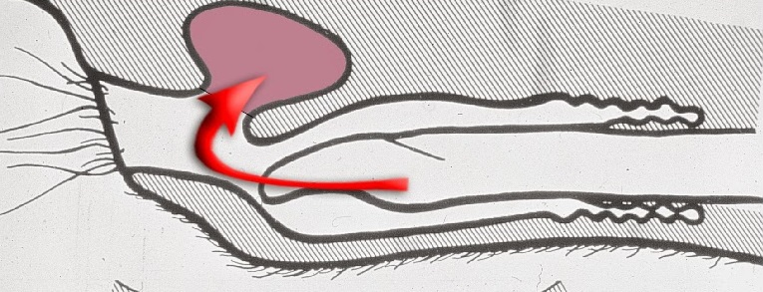
- Pederasty - Rectal copulation e.g. boar
Onanism - Abortive ejaculate e.g. boar
Balling up - Masturbation (inserting penis into
prepucial diverticulum) e.g. boar

Slide 6
Sexual pattern/behavior is according to
- Genetic makeup
- Physical and social environment
- Systematic components of male sexual behavior
1. Sexual arousal
2.Courtship
3.Penile Erection and protrusion
4. Mounting
5. Intromission
6. Ejaculation
7. Dismounting
8. Refractoriness
- One component - stimulator the next one

Slide 7
Sexual arousal
Represent the attraction between male – female
Visual…Auditory ….. Olfactory
Pheromones - Estrous female attract the male

Slide 8
Courtship
Activity before the mating
(close contact to female)
Stimulate and prepare the female for copulation
- Sniffing and licking – Female genitalia
Urine and perineal region - Bull/Ram/Buck
Female head – boar & stallion

Slide 9
- Vocalization –
Courting bleat – ram & buck
Courting grunt – swine
Neighing – stallion
No vocalization – bull
Nudging – (Gentle pushing to draw attention)
With foreleg – ram & buck
Nosing the flank – swine
Biting over back or neck – stallion

Slide 10
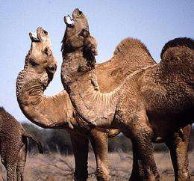
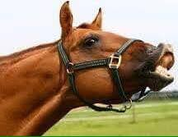
Flehmen’s reaction –
- Sexual behavior by the male during courtship
- Sniffing the genitalia & urine of estrous female
…. Male stand rigidly
…. Extended head & neck
…. Upcurling of the upper lip
- Shown by all species except boar

Slide 11
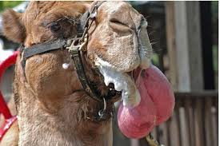
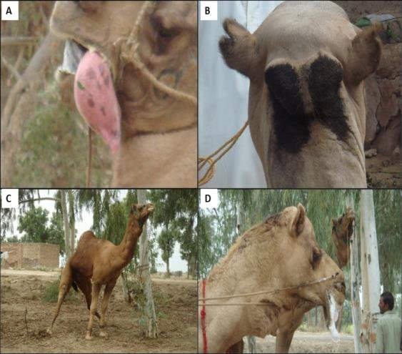
Male arabian camel – (contact to estrous female)
- Extrusion of soft palate
- Gurgling sound
- Urine marking/spraying
- Smudging the poll gland secretion
- Teeth grinding.

Slide 12
- Buck (courtship)
- Kicking, pawing, and nuzzling the female,
- Grunting
- Flehman response (curling of the upper lip).
Stallion
- Urine marking
(mark the place of estrous female)
- Nose-to-nose contact
- Soft nicker / Vocalization
- Sniffing, nibbling, nuzzling, and licking
- Interaction from shoulder to perineum
- Urinating pattern - Not seen in bull and ram

Slide 13
Dog
- Multiple unsuccessful mountings (play)
- Sniffing perineal and vulvar region
- Flehmen reaction
Tom
- Touch her nose with his nose
- Touch her perineal region
- Sniffing and Flehmen reaction
- Open mouth & closed eyes
- Approach queen from side or from back
- Grasp her neck in his mouth softly
- Positioning for mating

Slide 14
Penile Erection & protrusion
Penile erection - Cerebral cortex
- Lumbar spinal region
- Penile erection - Parasympathetic nervous system
Contraction of ischiocavernosus muscles (penis
erectile muscles) at root of penis
Contraction of bulbospongiosus muscle

Slide 15
Increased penile arterial blood flow
Reduce the venous drainage
Increase the hydrostatic pressure in the penis
Erection of penis
Relaxation of retractor penis muscles
Protrusion of penis out of prepuce

Slide 16
- Bull (Just before mating)
- Rests his chin on female back
- To & fro penile movement of erected penis
- Dribbling (Mainly from cowper’s gland)
- Cleansing the urethra
Stallion
- Penile oscillation
- Penile engorgement (blood filling)
- Penile rigidness

Slide 17
Tom –
- Stimulation of parasympathetic nerves of the
second sacral nerve roots
- Penile erection
- Stimulation of the sympathetic nerves at
lumbar 1-2 or of the hypogastric nerve
- Secretion of seminal fluid into the urethra
Stimulation of the internal pudendal
- (parasympathetic, sympathetic, somatic)
- Ejaculation

Slide 18
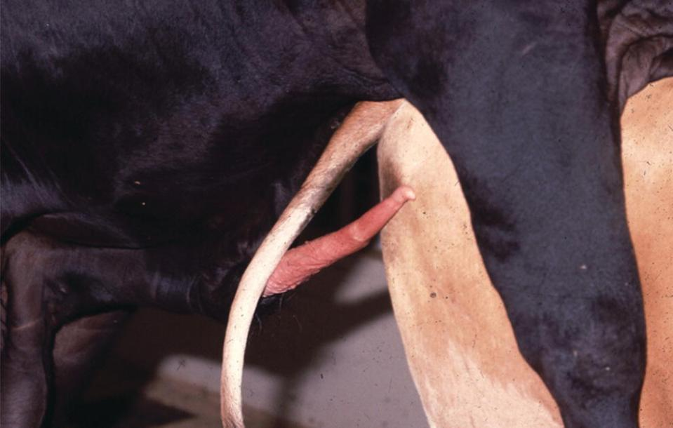
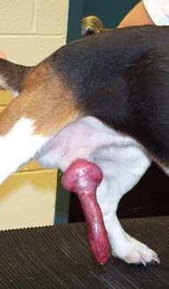
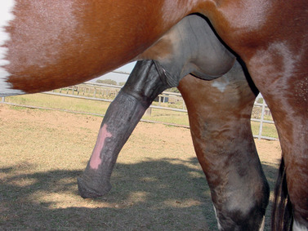
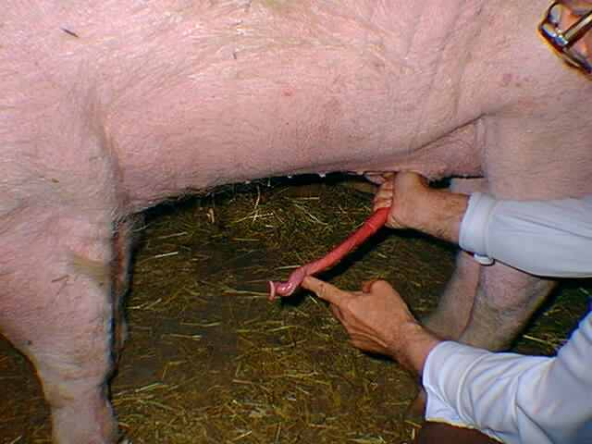

Slide 19
Mounting
- Bull - One or two unsuccessful mountings
- Grasping female firmly with forelegs
- Rhythmic pelvic swaying - seeking the vulva
Camel mates with female in sternal recumbancy
- Pressing on her neck or back
(To make the female recumbent )
- Squat on the female
- Direct the penis for seeking vulva
(in partial erected condition)

Slide 20
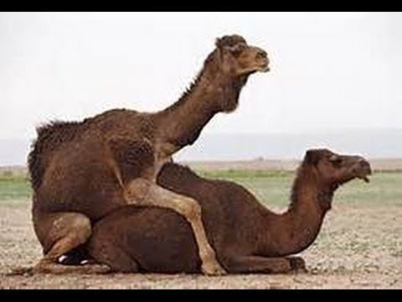

Slide 21
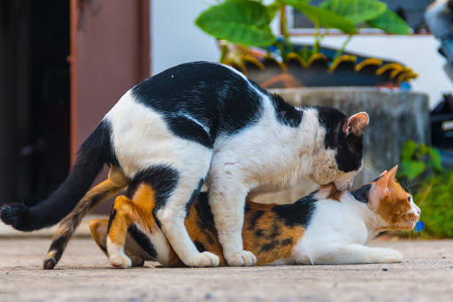
Dog –
-Mounting thrusting and dismounting
- Successful intromission
- Some prostatic clear sperm free fraction
- Clear the urethra
(urine traces & debris)
- Tom -
- Hold/grasp her neck with teeth

Slide 22
Intromission
Rhythmic movement of pelvic region
Contraction of abdominal muscles
Seeking vulva.
Superficial nerve endings of glans penis
- Proper heat and moisture
Penile alignment against the vulva
Intromission takes place with pelvic thrust

Slide 23
Full intromission .. after ejaculatory thrust in bulls
Copulation time – Seconds in cattle/Ram/Buck
40 sec in stallion
3-20 min in boar
5.5 min in camel
Paddling - Intromission and adjustment of tom
penis is helped by the hind limbs
paddling movement by queen
In camel, penis becomes fully extended after
complete intromission

Slide 24
Ejaculation
Sympathetic nervous system
Lower lumbar and sacral region of spine
Medial optic area of hypothalamus
Dopamine fascilitate and serotonin inhibit the
central control of ejaculation
Abdominal muscle (rectus abdominis) contract
Nerve stimulation
- Temperature…Tactile sensation…Pressure

Slide 25
- Oxytocin - Semen transport in epididymis & Vas D
- Contarction of sex glands
- Contraction of urethral muscles
- Ischiocavernosus and bulbourethral
muscles
….. Semen is released out of urethra
Main stimulus –
Temperature - Bull and ram
Pressure - Stallion, boar and dog
Semen deposition -
Os cervix - Bull, ram & buck
Uterus -Boar and stallion

Slide 26
Ejaculatory thrust (single thrust in ruminants)
- Both the hind limbs are in the air
- Bull rests his head over female back
Multiple pelvic thrust - boar and dog
Head moves backward at the time of ejaculation
- ram & buck
- Motionless male with scrotal contractions – boar
- Biting on female neck – stallion

Slide 27
In stallion ejaculation
- Rhythmic contractions of the
Ischiocavernosus
Bulbospongiosus
Urethralis muscles
- 7 to 9 pelvic thrusts
- 5 to 10 successive forceful ejaculations
- Downward movement of the tail -tail flagging
- Urethral peristalsis (ventral surface of penis)
- Rhythemic contraction of hind leg muscles
Time from intromission to ejaculate – 10 to 15 sec
Time between ejaculate to dismount – 8 sec

Slide 28
In Dog - Copulatory tie or coital lock
- Swelling of bulbus glandis
- Constriction of vulvar muscles
Queen - “Cat cry” … “Rage reaction”
- Queen - No sexual receptivity for 10-20 minutes
- Again receptive
- Several matings (av. 7 intromission/hr)
- Ensure sufficient LH surge – Ovulation
- Rolls and licks the vulva after copulation
Camel - Stretched body and extends neck
- Ejaculation - several times during mating

Slide 29
Dismounting
Dismounting
- Penis is withdrawn back into prepuce
- Buffalo bull - more lethargic than cattle bull
After dismounting –
- Licking of penis – buck
- Streching the head and neck – buck
- No post coital reaction - bull
Stallion - Dismounts after 20 to 30 seconds
- Remains in proximity to female (minutes)
- Investigate for any vaginal fluid
- may display flehmen reaction.

Slide 30
Dog –
- Face away (tail-to-tail) condition
- Penis is twisted through 180⁰
- Occlusion of efferent penile veins
- Slow veinous out flow
- Hydrostatic pressure - Longer penile turgidity
3rd fraction of ejaculate (about 30 ml sperm free)
- Pumped in to vagina to flush the sperm rich
fraction into uterus
Reduction in penile blood occlusion along with
vulvar muscle relaxation - Unlocking
- Coital tie - 20 minutes (5 to 60 min).

Slide 31
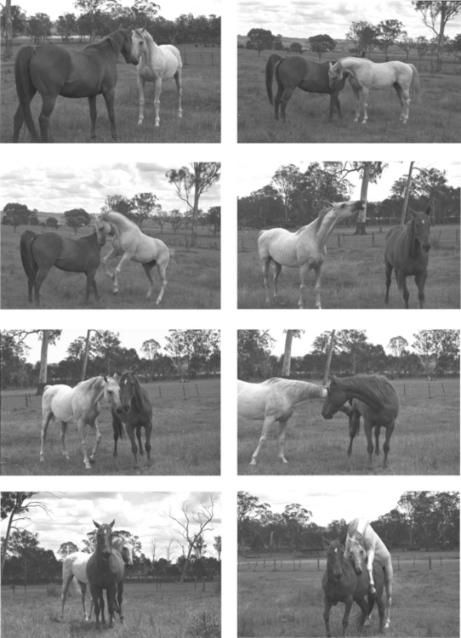

Slide 32
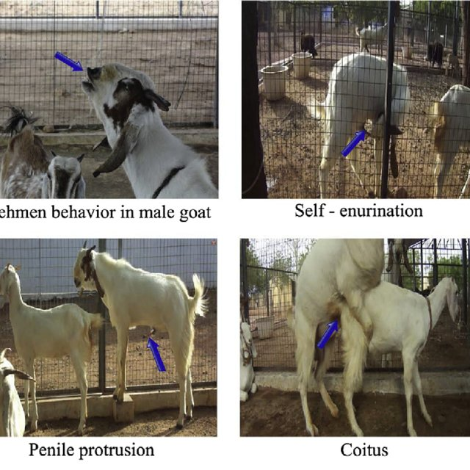

Slide 33
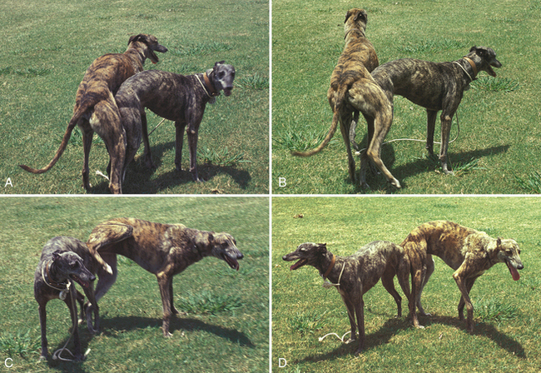

Slide 34
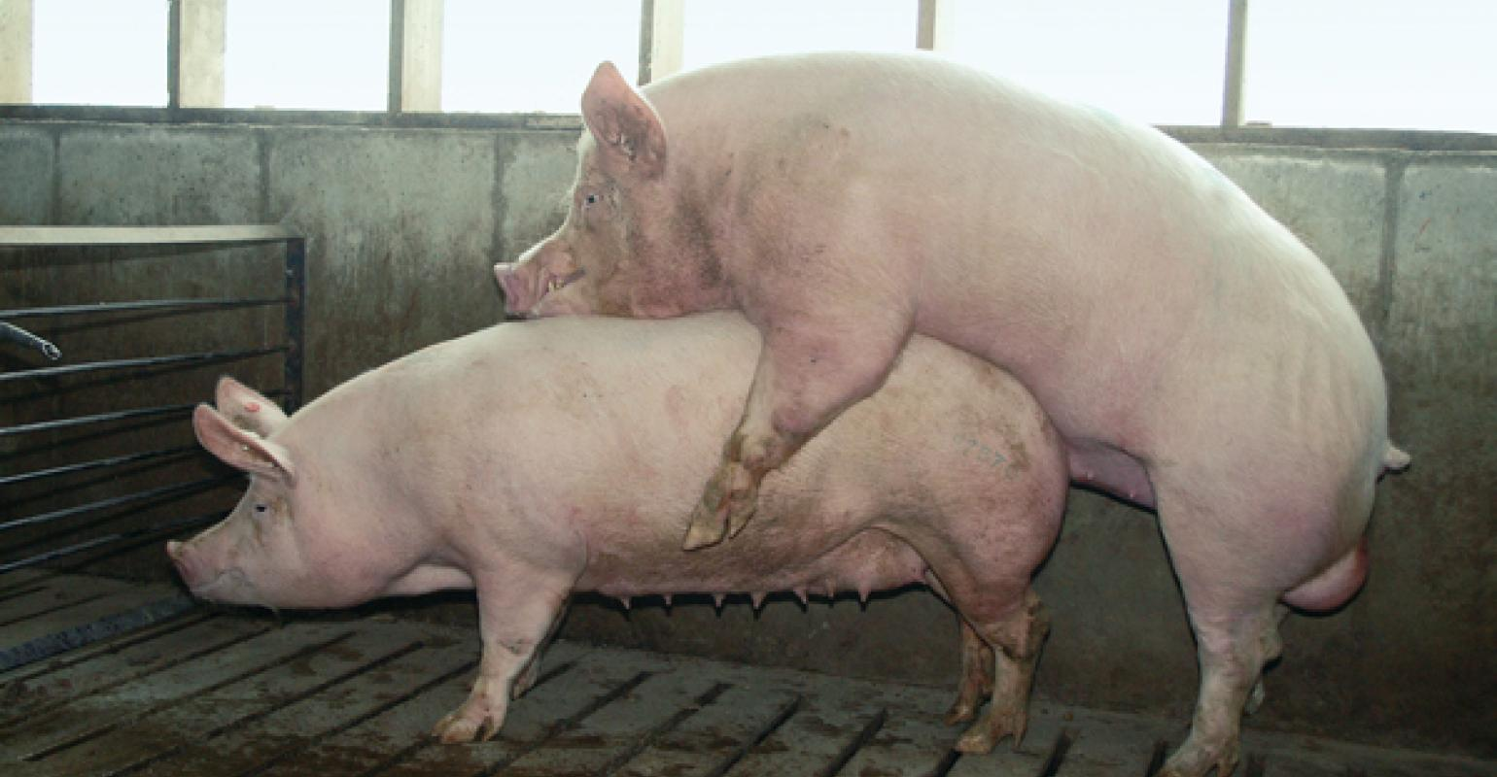
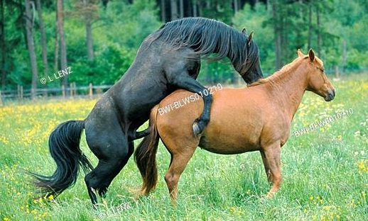

Slide 35
Refractoriness
State of sexual exhaustion after ejaculation
Period between 1st ejaculate to second mount
No sexual interest in female after copulation
Buck, boar and stallion reach sexual exhaustion
earlier than bull & ram
i.e. more no. of ejaculates can be achieved by bull
& ram (bull can give 30-35 services/day … MAX)

